Slide 1
Top 10 busiest drop-off spots in NYC
0.0 0.0 273160
-73.991 40.750 48071
-73.991 40.749 37251
-73.990 40.750 36223
-73.990 40.751 34483
-73.994 40.750 32196
-73.992 40.749 22552
-73.990 40.756 22257
-73.872 40.774 21570
-74.004 40.742 21209

Slide 2
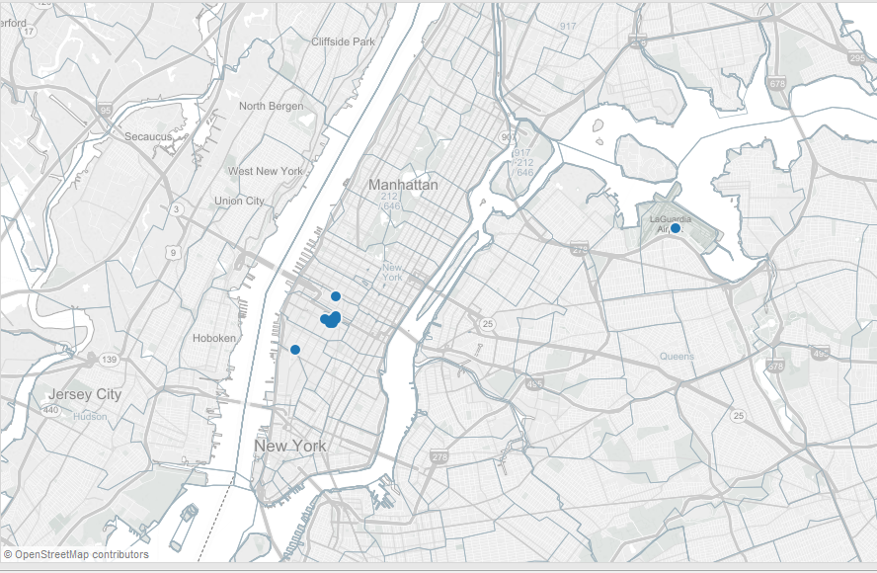
A better understanding

Slide 3
Top 10 busiest pickup spots in NYC
0.0 0.0 264892
-73.991 40.750 62765
-73.991 40.749 50539
-73.994 40.751 48641
-73.870 40.773 46237
-73.990 40.756 45922
-73.994 40.750 36949
-73.776 40.645 34101
-74.005 40.740 33159
-73.988 40.748 31968

Slide 4
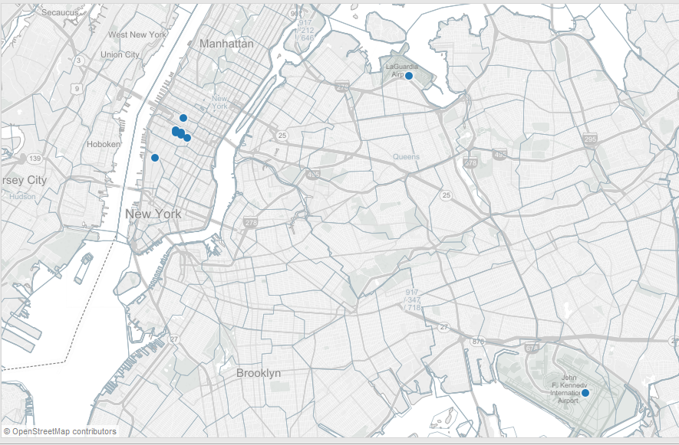
A better understanding

Slide 5
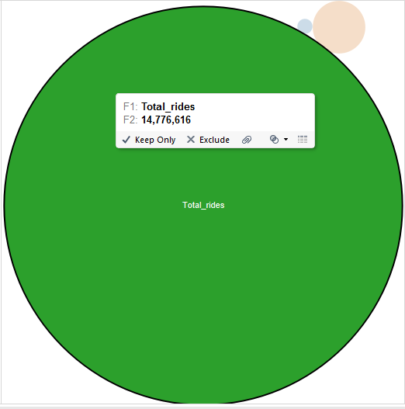
The GPS Anomaly

Slide 6
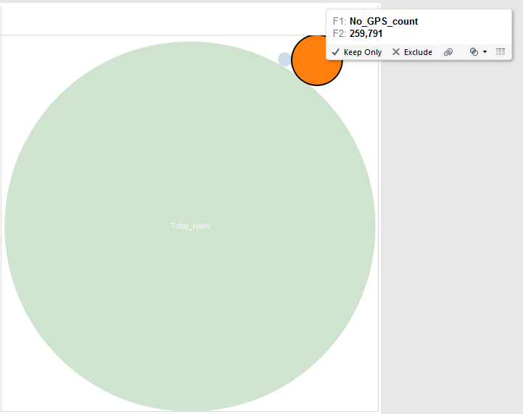

Slide 7
